Slide 1
Introduction to Recursion

Slide 2
Introduction to Recursion
So far, we have seen methods that call other functions.
  For example, the main() method calls the square() function.
Recursive Method:
  A recursive method is a method that calls itself.(direct recursion)
main()
square()
compute()

Slide 3
Visualizing Recursion
To understand how recursion works, it helps to visualize what’s going on.
To help visualize, we will use a common concept called the Stack.
A stack basically operates like a container of trays in a cafeteria. It has only two operations:
  Push: you can push something onto the stack.
  Pop: you can pop something off the top of the stack.
Let’s see an example stack in action.

Slide 4
Stacks
The diagram below shows a stack over time.
We perform two pushes and one pop.
8
2
2
2
Time: 0
Empty Stack
Time 1:
Push “2”
Time 2:
Push “8”
Time 3:
Pop: Gets 8
Time 4:
Pop: Gets 2

Slide 5
Stacks and Methods
When you run a program, the computer creates a stack for you.
Each time you invoke a method, Activation record of the method is placed on top of the stack.
When the method returns or exits, the activation record of the method is popped off the stack.
Activation record consists of current values of local variables and return address.

Slide 6
Stacks and Methods
square()
main()
main()
main()
Time: 0
Empty Stack
Time 1:
Push: main()
Time 2:
Push: square()
Time 3:
Pop: square()
returns a value.
method exits.
Time 4:
Pop: main()
returns a value.
method exits.

Slide 7
Stacks and Recursion
Each time a method is called, you push the method’s AR on the stack.
Each time the method returns or exits, you pop the method’s AR off the stack.
If a method calls itself recursively, you just push another copy of the method’s AR onto the stack.
We therefore have a simple way to visualize how recursion really works.

Slide 8
Computing Factorials

Slide 9
Factorials
Computing factorials are a classic problem for examining recursion.
A factorial is defined as follows:
  n! = n * (n-1) * (n-2) …. * 1;
For example:
  1! = 1 (Base Case)
  2! = 2 * 1 = 2
  3! = 3 * 2 * 1 = 6
  4! = 4 * 3 * 2 * 1 = 24
  5! = 5 * 4 * 3 * 2 * 1 = 120

Slide 10
Iterative Approach
ll fact_iter(int n)
{
ll result = 1;
for (int i = 1; i <= n; i++)
{
result *= i;
}
return result;
}

Slide 11
Factorials
Computing factorials are a classic problem for examining recursion.
A factorial is defined as follows:
  n! = n * (n-1) * (n-2) …. * 1;
For example:
  1! = 1 (Base Case)
  2! = 2 * 1 = 2
  3! = 3 * 2 * 1 = 6
  4! = 4 * 3 * 2 * 1 = 24
  5! = 5 * 4 * 3 * 2 * 1 = 120
If you study this table closely, you
will start to see a pattern.

Slide 12
Seeing the Pattern
Seeing the pattern in the factorial example is difficult at first.
But, once you see the pattern, you can apply this pattern to create a recursive solution to the problem.
Divide a problem up into:
  What it can do (usually a base case)
  What it cannot do
    What it cannot do resembles original problem
    The function launches a new copy of itself (recursion step) to solve what it cannot do.

Slide 13
Factorials
Computing factorials are a classic problem for examining recursion.
A factorial is defined as follows:
  n! = n * (n-1) * (n-2) …. * 1;
For example:
  1! = 1 (Base Case)
  2! = 2 * 1 = 2
  3! = 3 * 2 * 1 = 6
  4! = 4 * 3 * 2 * 1 = 24
  5! = 5 * 4 * 3 * 2 * 1 = 120
If you study this table closely, you
will start to see a pattern.
The pattern is as follows:
You can compute the factorial of
any number (n) by taking n and
multiplying it by the factorial of (n-1).
For example:
5! = 5 * 4!
(which translates to 5! = 5 * 24 = 120)

Slide 14
Recursive Solution
int fact(int n)
{
if(n==0||n==1) //Base condition
return 1;
else
return(n * fact(n-1)); //Recursive call
}

Slide 15
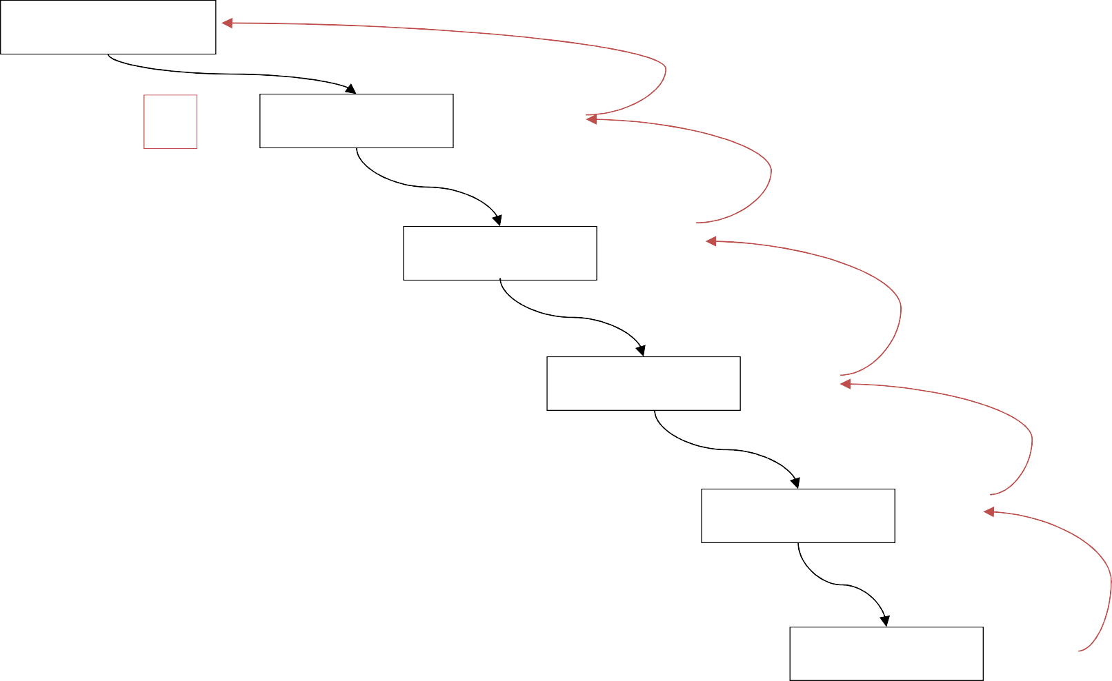
Recursion - How is it doing!
rFact(5) = 120
5
x
rFact(4) = 24 = 120
Notice that the recursion isn’t finished at the bottom --
It must unwind all the way back to the top in order to be
done.
x
rFact(3) = 6
= 24
4
3
x
rFact(2) = 2
= 6
int fact(int n)
{
if(n==0||n==1)
return 1;
else return(n * fact(n-1));
}
2
x
rFact(1) = 1
= 2
1
x
rFact(0) = 1
= 1

Slide 16
Recursive factorial
returns factorial(4)
factorial(4)
Step 9: return 24
Step 0: executes factorial(4)
return 4 * factorial(3)
Stack
Main method
Step 8: return 6
Step 1: executes factorial(3)
return 3 * factorial(2)
Step 7: return 2
Step 2: executes factorial(2)
return 2 * factorial(1)
Step 6: return 1
Step 3: executes factorial(1)
return 1 * factorial(0)
Step 5: return 1
Step 4: executes factorial(0)
return 1

Slide 17
Finding the factorial of 3
fact(1)
1
fact(2)
fact(2)
fact(2)
2
fact(3)
fact(3)
fact(3)
fact(3)
fact(3)
6
main()
main()
main()
main()
main()
main()
Time 2:
Push: fact(3)
Time 3:
Push: fact(2)
Time 4:
Push: fact(1)
Time 5:
Pop: fact(1)
returns 1.
Time 6:
Pop: fact(2)
returns 2.
Time 7:
Pop: fact(3)
returns 6.
Inside findFactorial(3):
if (number <= 1) return 1;
else return (3 * factorial (2));
Inside findFactorial(2):
if (number <= 1) return 1;
else return (2 * factorial (1));
Inside findFactorial(1):
if (number <= 1) return 1;
else return (1 * factorial (0));

Slide 18
Fibonacci Numbers: Recursion
fibonacci(0) = 0
fibonacci(1) = 1
fibonacci(n) = fibonacci(n-1) + fibonacci(n-2) [for n>1]
So fibonacci(4)
= fibonacci(3) + fibonacci(2)
= (fibonacci(2) + fibonacci(1)) + (fibonacci(1) + fibonacci(0))
= ((fibonacci(1) + fibonacci(0)) + 1) + (1 + 0)
= ( 1 + 0 ) + 1) + (1 + 0)
= 3

Slide 19
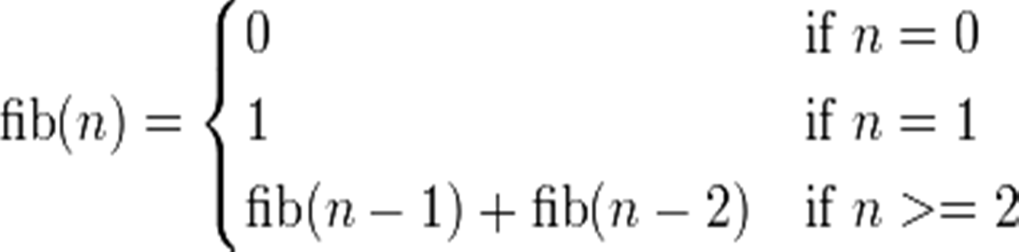
Fibonacci Numbers: Recursion
Fibonacci series is 0,1, 1, 2, 3, 5, 8 …
int rfibo(int n)
{
if (n <= 1) return n;
else
Output:
n = 4
fib = 2
return (rfibo(n-1) + rfibo(n-2));
}

Slide 20
Reversing a Number: Recursion
1/3/2013
int rev(int num){ static int n = 0; if(num > 0)
n = (n* 10) + (num%10) ; else
return n;
return rev(num/10);
}
Output:
n = 234
rev = 432

Slide 21
GCD: Recursion
The greatest common divisor (gcd) of two positive integers is the largest integer that divides evenly into both of them. For example, the greatest common divisor of 24 and 9 is 3 since both 24 and 9 are multiples of 3, but no integer larger than 3 divides evenly into 24 and 9.
int gcd(int x, int y)
{
if (x == 0) return (y);
if (y==0)
return (x); return gcd(y, x % y);
}

Slide 22
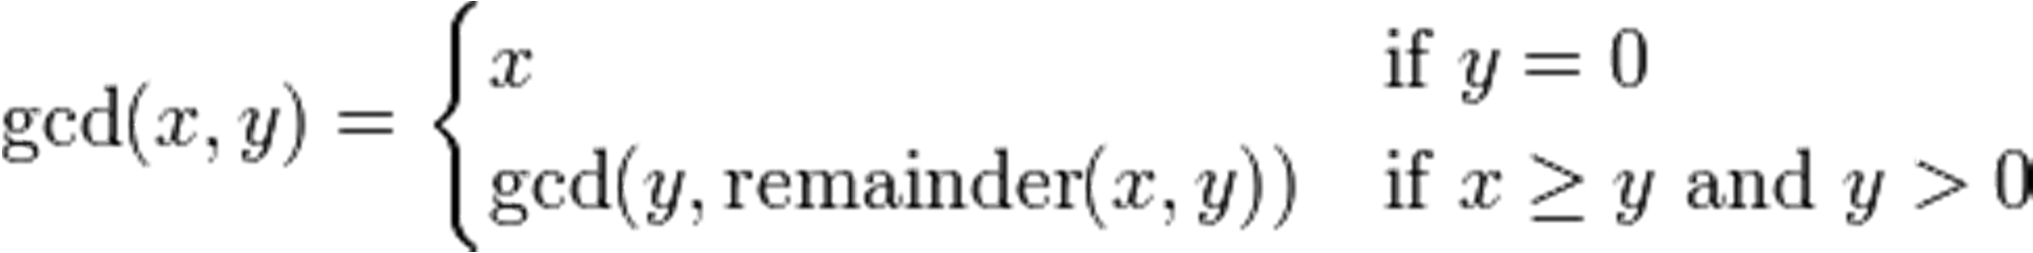
int gcd(int x, int y)
{
if (x == 0) return (y);
if (y==0)
return (x); return gcd(y, x % y);
}

Slide 23
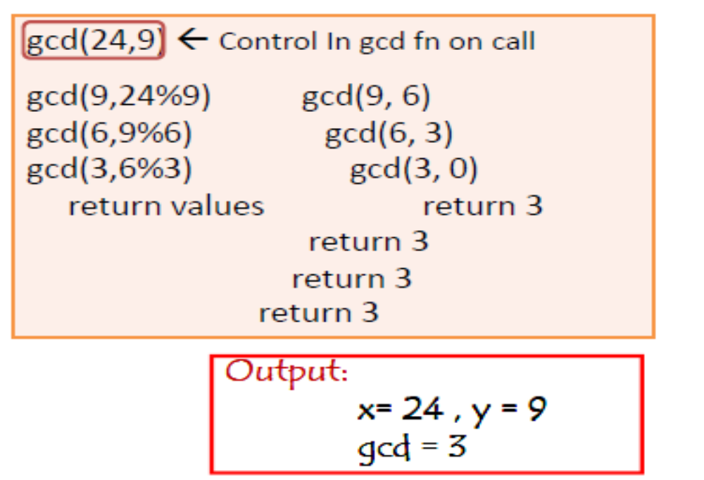

Slide 24
Non tailed recursion
void PrintFun(int t){
if(t<1) return;
else{
cout<<t;
PrintFun(t-1);
cout<<t;
return;}
}

Slide 25
Sorting: Recursion
1/3/2013
sort(list, n);// call of fn & display of sorted array in main()
void sort(int list[], int ln){ int i, tmp, min;
if (ln == 1) return;
/* find index of smallest no */
min = 0;
for(i = 1; i < ln; i++) if (list[i] < list[min]) min = i;
/* move smallest element to 0-th element */
tmp = list[0]; list[0] = list[min]; list[min] = tmp;
/* recursion */
sort(&list[1], ln-1); }
Output:
Orign. array-: 33 -2 0 2 4
Sorted array -: -2 0 2 4 33

Slide 26
Recursion vs. Iteration
Iteration
  Uses repetition structures (for, while or do…while)
  Repetition through explicitly use of repetition structure
  Terminates when loop-continuation condition fails
  Controls repetition by using a counter
Recursion
  Uses selection structures (if, if…else or switch)
  Repetition through repeated method calls
  Terminates when base case is satisfied
  Controls repetition by dividing problem into simpler one

Slide 27
Recursion vs. Iteration (cont.)
Recursion
  More overhead than iteration
  More memory intensive than iteration
  Can also be solved iteratively
  Often can be implemented with only a few lines of code

